Slide 1
Object Oriented Programming in Java Week 7

Slide 2
Today
Interfaces and Abstract Classes
Polymorphism
Casting

Slide 3
interfaces
What are Interfaces?
Interfaces define the set of requirements for classes that want to conform to them
All the methods in interfaces are by default public
Classes implement interfaces by:
By declaring that a class will implement the interface with the implements keyword
By supplying the definitions for all methods in the interface
Properties of Interfaces
You cannot instantiate objects out of interfaces, but you can declare references
You can use instanceof operator to verify if an object implements an interface
You can build hierarchy of interfaces
You can have constants in interfaces
Variables declared inside interfaces are by default public, final and static
Classes may implement multiple interfaces
An object of such a class is additionally considered to be of types of all the interfaces the class implements

Slide 4
Interfaces vs Abstract classes
Interfaces are often (although not always) named such as Comparable, Runnable, Iterable, ….
They represent the class’s additional abilities over and above what it can do through inheritance
These additional abilities cut across inheritance hierarchies
Inheritance makes all child classes to exhibit a certain behavior, but interface allows a class to exhibit additional behavior
Abstract classes may have instance fields and methods. Interfaces cannot.
An abstract class can implement an interface
A class can inherit from only one class but may implement multiple interfaces
Abstract classes exist at the top of inheritance hierarchies as the super classes
Interfaces may be implemented at any level in an inheritance hierarchy
Notes:
Abstract class may or may not have abstract methods

Slide 5
Introducing new methods into interfaces
Default and static methods are supported in interfaces with Java 8.
Private methods and private static method are allowed in interfaces with Java 9.
Default Methods
Default methods enable to add new functionality to the interfaces while the implementation classes may remain the same. A default method can invoke other methods of the interface.
Implementation class may do the following:
Inherit the default method by not including in the class definition
Redeclare the default method with abstract keyword and make the class abstract
Override the default method
Static Methods
Static functions in the interface make it easier to organize helper methods by keeping them in the same interface rather than in a separate class
Private Methods in Interfaces
Private methods can only be visible inside the interface
They are mainly for improving code reuse inside interfaces
Notes:
You can introduce new methods as long as you make them static or default or private

Slide 6
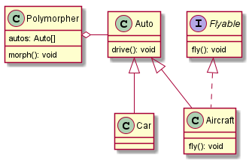
Polymorphism with Interfaces - 1
Which methods must be implemented in Car?
Which methods must be implemented in Aircraft?
?
?

Slide 7
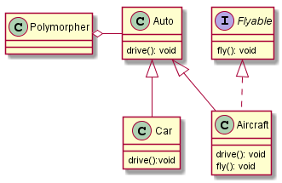
Polymorphism
public class Auto {
void drive() {
System.out.println("Auto driving");
}
}
public interface Flyable {
void fly();
}
public class Car extends Auto{
@Override
void drive() {
System.out.println("Car driving");
}
}
public class Polymorpher {
Auto[] autos = new Auto[3];
public static void main(String[] args) {
Polymorpher p = new Polymorpher();
p.autos[0] = new Auto();
p.autos[1] = new Car();
p.autos[2] = new Aircraft();
for (Auto auto : autos) {
auto.drive();
}
}
}
public class Aircraft extends Auto implements Flyable{
@Override
void drive() {
System.out.println("Aircraft driving");
}
@Override
public void fly() {
System.out.println("Aircraft flying");
}
}

Slide 8
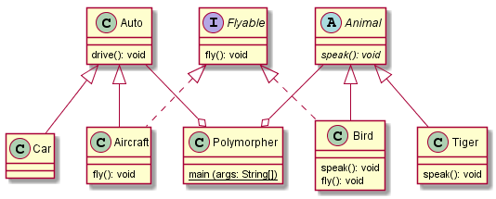
Polymorphism with Interfaces - 2
?
?
Which methods must be implemented in Bird?
Which methods must be implemented in Tiger?

Slide 9
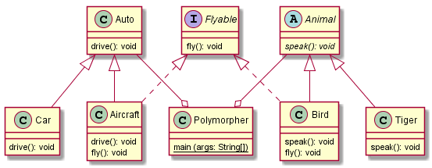
Polymorphism with Interface - 2
public abstract class Animal {
abstract void speak();
}
public class Tiger extends Animal{
@Override
void speak() {
System.out.println("Roar!");
}
}
public class Polymorpher {
Animal[] animals = new Animal[2];
public static void main(String[] args) {
Polymorpher p = new Polymorpher();
p.animals[0] = new Tiger();
p.animals[1] = new Bird();
for (Animal animal : animals) {
animal.speak();
if (animal instanceof Flyable) {
((Flyable) animal).fly();
}
}
}
}
public class Bird extends Animal implements Flyable{
@Override
public void fly() {
System.out.println("Bird flying");
}
@Override
void speak() {
System.out.println("Tweet!");
}
}

Slide 10
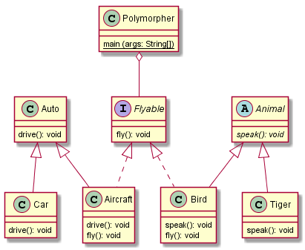
Polymorphism with Interface - 2
public class Polymorpher {
Flyable[] flyables = new Flyable[2];
public static void main(String[] args) {
Polymorpher p = new Polymorpher();
p.flyables[0] = new Aircraft();
p.flyables[1] = new Bird();
for(Flyable flyable : flyables) {
flyable.fly();
}
}
}

Slide 11
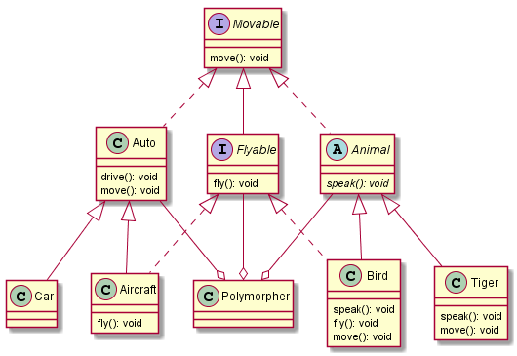
Polymorphism with Interfaces - 3
Which methods must be implemented by Car?
Which methods must be implemented by Tiger?
?
?
?
?
Which methods must be implemented by Aircraft?
Which methods must be implemented by Bird?

Slide 12
Interfaces across hierarchies
public class Auto implements Movable{
void drive() {
System.out.println("Auto driving");
}
@Override
public void move() {
System.out.println("Auto moving");
}
}
public abstract class Animal implements Movable {
abstract void speak();
}
public class Bird extends Animal implements Flyable{
@Override
public void move() {
System.out.println("Bird moving");
@Override
public void fly() {
System.out.println("Bird flying");
}
@Override
void speak() {
System.out.println("Tweet!");
}
}}
public class Tiger extends Animal{
@Override
void speak() {
System.out.println("Roar!");
}
@Override
public void move() {
System.out.println("Tiger moving");
}
}

Slide 13
Polymorphism with interfaces - 3
public class Polymorpher {
Movable[] movables = new Movable[5];
public static void main(String[] args) {
Polymorpher p = new Polymorpher();
p.movables[0] = new Auto();
p.movables[1] = new Car();
p.movables[2] = new Aircraft();
p.movables[3] = new Tiger();
p.movables[4] = new Bird();
for (Movable movable : p.movables) {
movable.move();
}
}
}

Slide 14
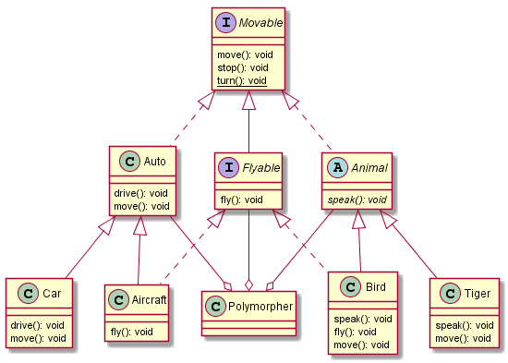
Default and Static interfaces

Slide 15
Default and Static interfaces
public interface Movable {
void move();
default void stop() {
System.out.println("Movable stopping");
}
static void turn() {
System.out.println("Movable turning");
}
}
public class Polymorpher {
public static void main(String[] args) {
//in addition to code from last slide
for (Movable movable : p.movables) {
movable.move();
movable.stop();
Movable.turn();
}
}

Slide 16
Interface Example: Comparable
public class Book implements Comparable{
String title;
float price;
Book(String title, float price) {
this.title = title;
this.price = price;
}
@Override
public int compareTo(Object o) {
Book b = (Book) o;
return (this.title.compareTo(b.title));
}
public static void main(String[] args) {
Book b1 = new Book ("Core Java", 45.5f);
Book b2 = new Book ("Head First Java", 20);
System.out.println(b1.compareTo(b2));
}
}
public class Book implements Comparable{
String title;
float price;
Book(String title, float price) {
this.title = title;
this.price = price;
}
@Override
public int compareTo(Object o) {
return (int)(this.price - ((Book)o).price);
}
public static void main(String[] args) {
Book b1 = new Book ("Core Java", 45.5f);
Book b2 = new Book ("Head First Java", 20);
System.out.println(b1.compareTo(b2));
}
}
Do you see a problem here?

Slide 17
Comparable
public class Auto implements Comparable{
int numberOfPassengers;
Auto(int numberOfPassengers) {
this.numberOfPassengers = numberOfPassengers;
}
@Override
public int compareTo(Object o) {
return numberOfPassengers –
((Auto)o).numberOfPassengers;
}
}
public class Garage {
public static void main(String[] args) {
Auto[] autos = new Auto[5];
autos[0] = new Car(4);
autos[1] = new Aircraft(100);
autos[2] = new Car(7);
autos[3] = new Aircraft(2);
autos[4] = new Car(3);
Arrays.sort(autos); //sorts using compareTo()
for (Auto auto : autos) {
System.out.println(auto.numberOfPassengers);
}
}}
public class Car extends Auto{
Car(int numberOfPassengers) {
super(numberOfPassengers);
}}
public class Aircraft extends Auto {
Aircraft(int numberOfPassengers) {
super(numberOfPassengers);
}}

Slide 18
Benefits of Polymorphism
Generic Programming: Polymorphism enables you to use just one type and any subclass is taken care of
Dynamic Binding: Correct implementation (right behavior) is obtained via the actual type
Extensibility: A new class can be added into the hierarchy without changing the generic code

Slide 19
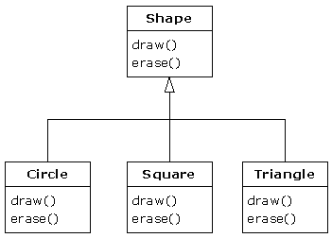

Pure Inheritance vs Extension (Substitution Principle)
Base class establishes the interface for the whole inheritance hierarchy. Subclasses override the implementation without adding new methods.
Notes:
Because derived class objects can be perfectly substituted for the base class, and you never need to know any extra information about the subclasses when you’re using them:
Open-closed principle: A new type of shape can be introduced into the inheritance hierarchy without changing the code in the “Talks to Shape” box. Everything is handled through polymorphism.

Slide 20
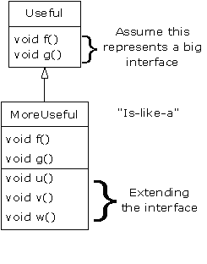
Pure Inheritance vs Extension (Substitution Principle)
Sub classes have other features that require additional methods to implement
The extended part of the interface in the derived class is not available from the base class
So you can’t call the new methods:
You would need to rediscover the exact type of the object so you can access the extended methods of that type
Casting

Slide 21
Casting
An object reference of type super class can refer to any object of sub classes
The reverse is not true; you need an explicit cast in order to compile.
You can cast within an inheritance hierarchy.
Try to minimize the casting as possible.
Use instanceof operator before casting a super class object to a sub class one if you need to cast.
public class CastingDemonstrate {
public static void main(String argv[]) {
Employee e = new Employee();
Manager m = new Manager();
Engineer en = new Engineer();
e = m; // OK
//m = e; // compile error
e = new Manager();
// m = e; // again, compile error.
m = (Manager)e;
e = new Engineer();
// m = (Manager)e; // run time cast exception.
if (e instanceof Manager) {
m = (Manager)e;
}
}
}
class Employee {
}
class Manager extends Employee {
}
class Engineer extends Employee {
}

Slide 22
Is Java Always Late-Binding?
Yes, always, except for final, static and private methods
final methods can’t be overridden, so the compiler knows to bind it
The compiler may be able to do some speed optimizations for a final method, but we programmers are usually lousy at estimating where speed bottlenecks are…
In C++, binding is always at compile-time, unless the programmer says otherwise

Slide 23
Overriding private methods?
If you define a method in a subclass with the same signature of a private method in super class, you are defining a new method in the sub class
This is not a good programming practice
class E {
private void f() {
System.out.println("E");
}
public void g() {
f();
}
}
public class D extends E {
private void f() {
System.out.println("D");
}
public void g() {
f();
}
public static void main(String[] args) {
E e = new E();
e.g();
D d = new D();
d.g();
}
}
What if class D doesn’t define g() at all?

Slide 24
Overloading an inherited method
It is possible but not a good programming practice
class E {
private void f() {
System.out.println("E");
}
public void g() {
f();
}
}
public class D extends E {
private void f() {
System.out.println("D");
}
public void g() {
f();
}
public void g(int i) {
f();
}
public static void main(String[] args) {
E e = new E();
D d = new D();
d.g();
d.g(1);
}
}
What if class D doesn’t define g() at all?

Slide 25
Behavior of polymorphic methods inside constructors
Inside Java constructors, eliminate calls to methods that can be overridden
In general, keep the constructors light-weight
class E {
private void f() {
System.out.println("E");
}
E() {
g();
}
public void g() {
f();
}
}
public class D extends E {
private void f() {
System.out.println("D " + i);
}
public void g() {
f();
}
D() {
i = 10;
g();
}
private int i;
public static void main(String[] args) {
D d = new D();
}
}

Slide 26
Object Class
Object class is the ultimate ancestor of all classes in Java.
It defines a number of methods.
See at https://docs.oracle.com/en/java/javase/17/docs/api/

Slide 27
Some Object Methods
clone(): Creates and returns a copy of this object
Returns an Object
equals(): Indicates whether some other object is "equal to" this one
Returns a boolean
getClass(): Returns the runtime class of an object
Returns a Class
toString(): Returns a string representation of the object
Returns a String
hashCode(): Returns an integer hash code of the object
Returns an int
Notes:
If you redefine the equals method, you will also need to redefine the hashCode method for objects that users might insert into a hash table.

Slide 28
Minimal class description
For any class you define in homework assignments, consider defining:
Constructor, possibly overloaded constructors
Without a default constructor if applicable
Private instance members
Public setter/getter methods for private members where applicable
toString() method
equals() method if applicable
hashCode() method if applicable
clone() method if applicable
Comparable interface if applicable
Documentation
Follow the coding conventions suggested in Chapter 4 of Core Java 1
We will add more into the minimal class description list as we progress in the semester.

Slide 29
Exercise - Order of Constructor Calls
https://github.com/BruceEckel/OnJava8-Examples/blob/master/polymorphism/Sandwich.java
class Meal {
Meal() {
System.out.println("Meal()");
}
}
class Bread {
Bread() {
System.out.println("Bread()");
}
}
class Cheese {
Cheese() {
System.out.println("Cheese()");
}
}
class Lettuce {
Lettuce() {
System.out.println("Lettuce()");
}
}
class Lunch extends Meal {
Lunch() {
System.out.println("Lunch()");
}
}
class PortableLunch extends Lunch {
PortableLunch() {
System.out.println("PortableLunch()");
}
}
class Sandwich extends PortableLunch {
private Bread b = new Bread();
private Cheese c = new Cheese();
private Lettuce l = new Lettuce();
public Sandwich() {
System.out.println("Sandwich()");
}
public static void main(String[] args) {
new Sandwich();
}
}

Slide 30
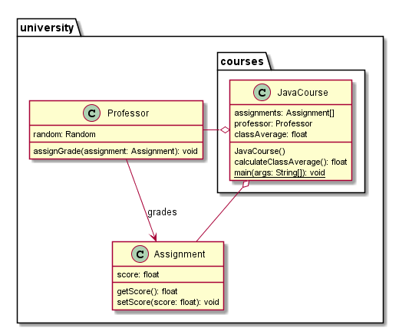
Exercise - Encapsulation

Slide 31
package ______1____;
_____2___ class Assignment {
___3_____ float score;
//getter
___4_____ float getScore() { return score; }
//setter
___5_____ void setScore(float score) { this.score = score;}
}
P
Question: Fill in the blanks
package _______10________;
import _____11______;
import _____12______;
____13_______ class JavaCourse {
Assignment[] assignments = new Assignment[100];
Professor professor = new Professor();
float classAverage;
JavaCourse() {
for (int i = 0; i < assignments.length; i++)
assignments[i] = new Assignment(); //initialize
}
float calculateClassAverage() {
float sum = 0;
for (Assignment assignment : assignments) {
sum += assignment.getScore();
}
return sum / assignments.length; //return average
}
public static void main(String[] args) {
JavaCourse javaCourse = new JavaCourse();
for (Assignment assignment : javaCourse.assignments) {
javaCourse.professor.assignGrade(assignment);
}
System.out.println(javaCourse.calculateClassAverage());
}}
package _____6______;
import java.util.Random;
_____7___ class Professor {
___8_____ Random random = new Random();
___9______ void assignGrade(Assignment assignment) {
//randomly generate a number between 0 and 100
assignment.setScore(random.nextInt(101));
}
}

